Slide 1
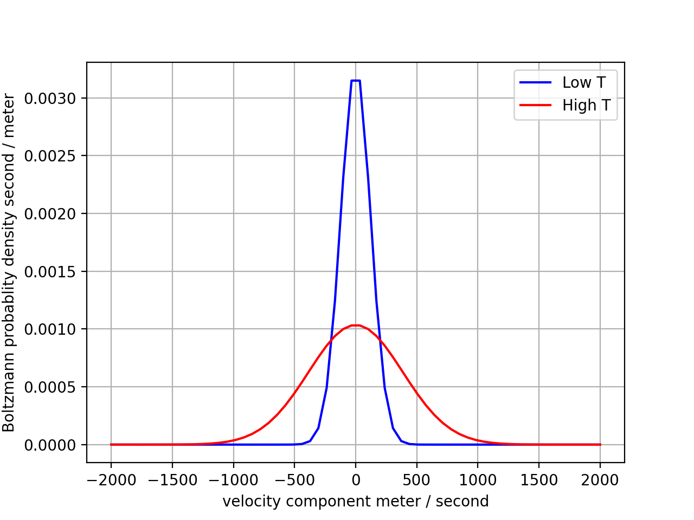
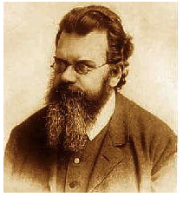
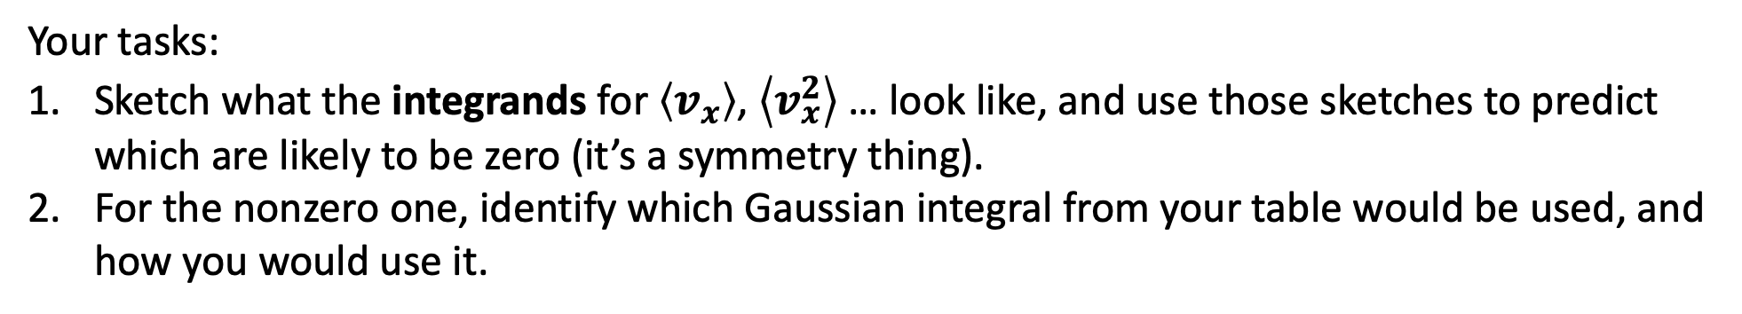
Blackboard work for finding Boltzmann moments ($\left\langle v_{x}\right\rangle$, $\left\langle v_{x}^{2}\right\rangle$, $\left\langle v_{x}^{3}\right\rangle$ …)
$$f_{B}=N_{B}\exp\left(−Dv_{x}^{2}\right)$$
$${N_{B}=\left(\frac{M}{2πRT}\right)}^{\frac{1}{2}}$$
$$D=\frac{M}{2RT}$$
Your tasks:
Sketch what the integrands for $\left\langle v_{x}\right\rangle$, $\left\langle v_{x}^{2}\right\rangle$ … look like, and use those sketches to predict which are likely to be zero (it’s a symmetry thing).
For the nonzero one, identify which Gaussian integral from your table would be used, and how you would use it.

